Slide 1


Major-2 Project
Cryptocurrency Market Analysis
Synopsis Presentation
Mentored By-:
Dr Gopal Singh Rawat
Assistant Professor
School of Systemics

Slide 2
Name | Roll-no | Sap-id | Contribution
Astha Kumari | R110219027 | 500076107 | Research,Technical,Documentation
Devanshu Pathak | R110219043 | 500075792 | Research,Technical,Documentation
Devang Tyagi | R110219041 | 500077078 | Research,Technical,Documentation
Gaurav Kumar | R110219053 | 500076068 | Research,Technical,Documentation

Slide 3
Content
Introduction
Motivation
Problem Statement
Objectives
Methodology
Literature Review
Technological Stack
Working Model (Technical Diagrams)
SWOT Analysis
Area of Application
Pert Chart
References

Slide 4
Introduction
Cryptocurrency market is constantly evolving and requires tracking of trends and developments.
Our project cryptocurrency market analysis through dashboard helps to visualize and analyse data for market insights. Fivetran enables efficient and automated transfer of data from S3 repository to Snowflake warehouse.
Snowflake provides a scalable and secure platform for storing and managing large volumes of data in cryptocurrency market.
Tableau is a data visualization tool for creating interactive dashboards and gaining insights into the cryptocurrency market.

Slide 5
Motivation
Cryptocurrency market analysis is crucial for informed investment decisions due to increasing acceptance of cryptocurrencies as a legitimate investment option.
Traditional quantitative analytical methods are inadequate for effectively analyzing vast amounts of data generated by cryptocurrency transactions and exchanges.
Visual analytics tools like Tableau offer a more efficient system of studying the cryptocurrency market by identifying hidden patterns and trends.
Effective cryptocurrency market analysis can help financial firms provide better returns to their clients and help investors and decision-makers identify potential opportunities and challenges.

Slide 6
Problem Statement
Cryptocurrencies are gaining popularity and complexity, requiring a comprehensive market analysis.
The enormous amount of data produced by the cryptocurrency market makes it difficult to analyse and comprehend its behaviour.
Conventional quantitative analytical techniques have been utilized to study the cryptocurrency market.
These methods are inadequate at detecting hidden patterns, trends, and correlations.
Implementing a data analysis pipeline using visual analytics tools like Tableau can identify previously difficult-to-uncover market patterns and trends.
This leads to more informed investment decisions and better returns for firms and clients.

Slide 7
Objectives
Following are the goals that we are planning to currently implement in our system-:
Create a data pipeline using Snowflake, Fivetran, S3, and Tableau for cryptocurrency market analysis.
Extract data from different cryptocurrency exchanges and transactions using Fivetran connectors and store it safely in a Snowflake data warehouse.
Use Tableau to analyze data and identify trends, patterns, and correlations in the bitcoin market through interactive visualizations.
Enhance decision-making by providing easy-to-understand and interactive visualizations, and promote the adoption of cryptocurrencies in the financial industry.

Slide 8
Literature Review
Park et. al [1] examines social media's role in influencing cryptocurrency reputation through visual analytics.
Mikhaylov et. al [2] explores the cryptocurrency industry through the lens of open innovation, highlighting potential growth strategies.
Farel et. al [3] offers an in-depth examination of the cryptocurrency sector, including its technical underpinnings and societal, economic, and governmental factors that affect its adoption and growth.
Mnif et al. [4] uses multifractal analysis to assess the effects of the COVID-19 pandemic on the cryptocurrency market, finding it to be highly volatile and multifractal.

Slide 9
Methodology
Identify key metrics/KPIs for market analysis and tracking.
Load Kaggle dataset into S3 repository.
Set up Fivetran account to create pipeline for data transfer to Snowflake warehouse.
Connect relevant information to extract and load data into Snowflake.
Connect Tableau to Snowflake and create custom dashboard layout.
Choose relevant visualizations and apply filters to allow user interaction.
Test and iterate dashboard design and functionality for accuracy and effectiveness.

Slide 10
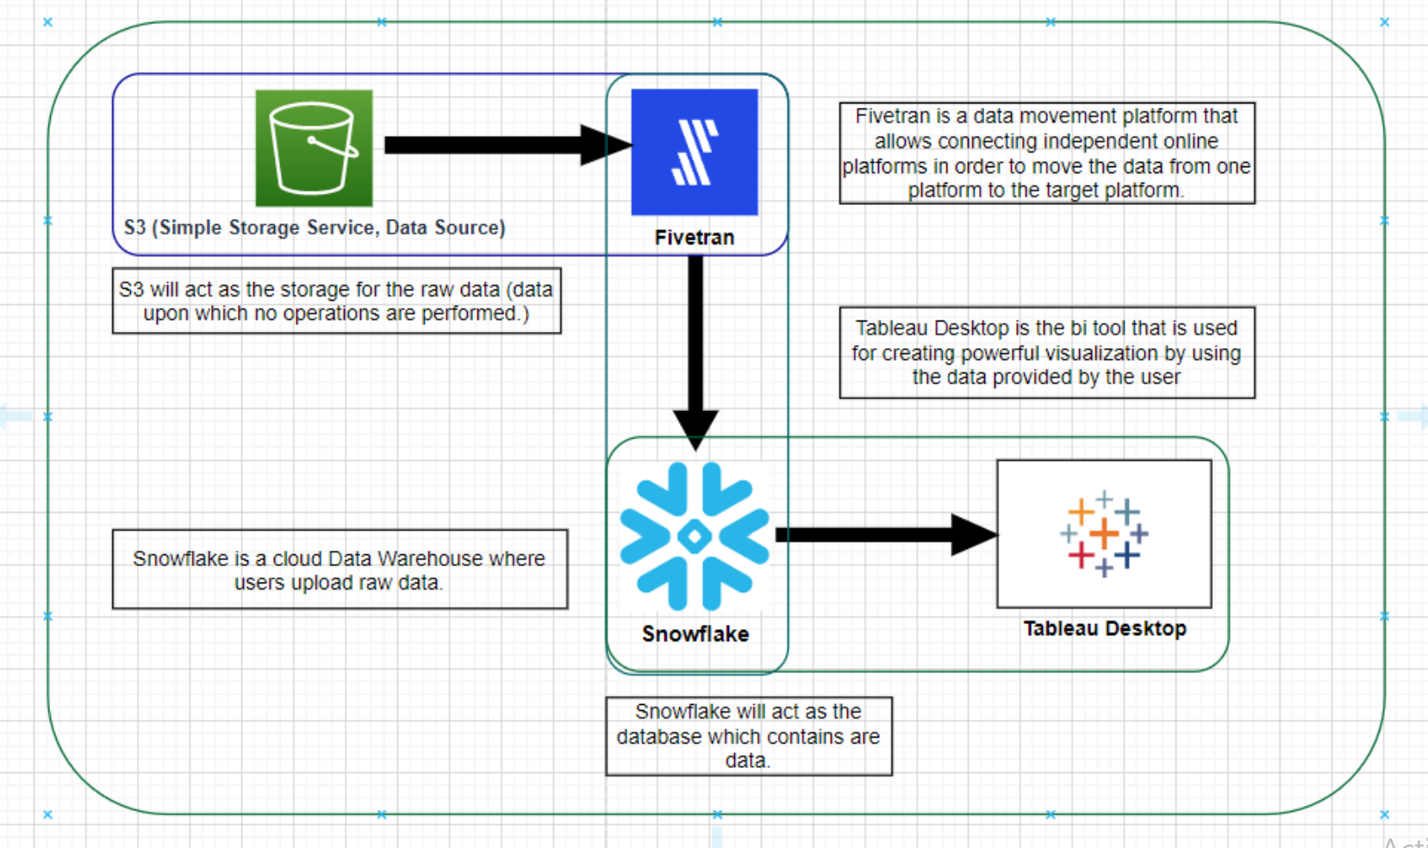
Application Flow Diagram

Slide 11
Technical Stack
Pipelining Tool: Fivetran
Warehousing Platform: Snowflake
Database: (Relational) SQL
Source Storage: S3 Bucket
Dashboarding Software: Tableau Desktop
Data Cleaning Tools: Tableau Prep / Alteryx

Slide 12
SWOT Analysis
1. Strength
1.1 The efficient and accurate data extraction is ensured using Fivetran to establish a pipeline for data collection.
1.2 By using Snowflake as a warehouse, data is safely kept and readily accessible for analysis.
1.3 Easy visualization and dashboard creation are made possible by Tableau's connection to the Snowflake warehouse.
2. Weakness
2.1 Dependence on data sources for accurate data collection may result in inaccurate analysis if data sources are unreliable.
2.2 The bitcoin market may become unstable and unclear as a result of a lack of regulation.
2.3 Because cryptocurrency market analysis involves specific knowledge and abilities, the pool of people who can perform it may be small.

Slide 13
SWOT Analysis
3. Opportunity
3.1 The growing interest in cryptocurrencies offers a chance for the discipline of cryptocurrency market analysis to advance.
3.2 The usage of cutting-edge tools like Tableau, Fivetran, and Snowflake creates a chance for the creation of novel analysis methods.
3.3 The market for cryptocurrencies is seeing an increasing need for data-driven insights, which opens the door for the creation of new goods and services.
4. Threat
4.1 The unstable and unpredictable market conditions that the volatile cryptocurrency market may provide may have an impact on the analysis's accuracy.
4.2 People and organizations engaged in bitcoin market analysis may face legal and financial risks because of the absence of regulation in the cryptocurrency market.
4.3 The project's success may be threatened by competition from other businesses and individuals who are also performing market analyses of cryptocurrencies.

Slide 14
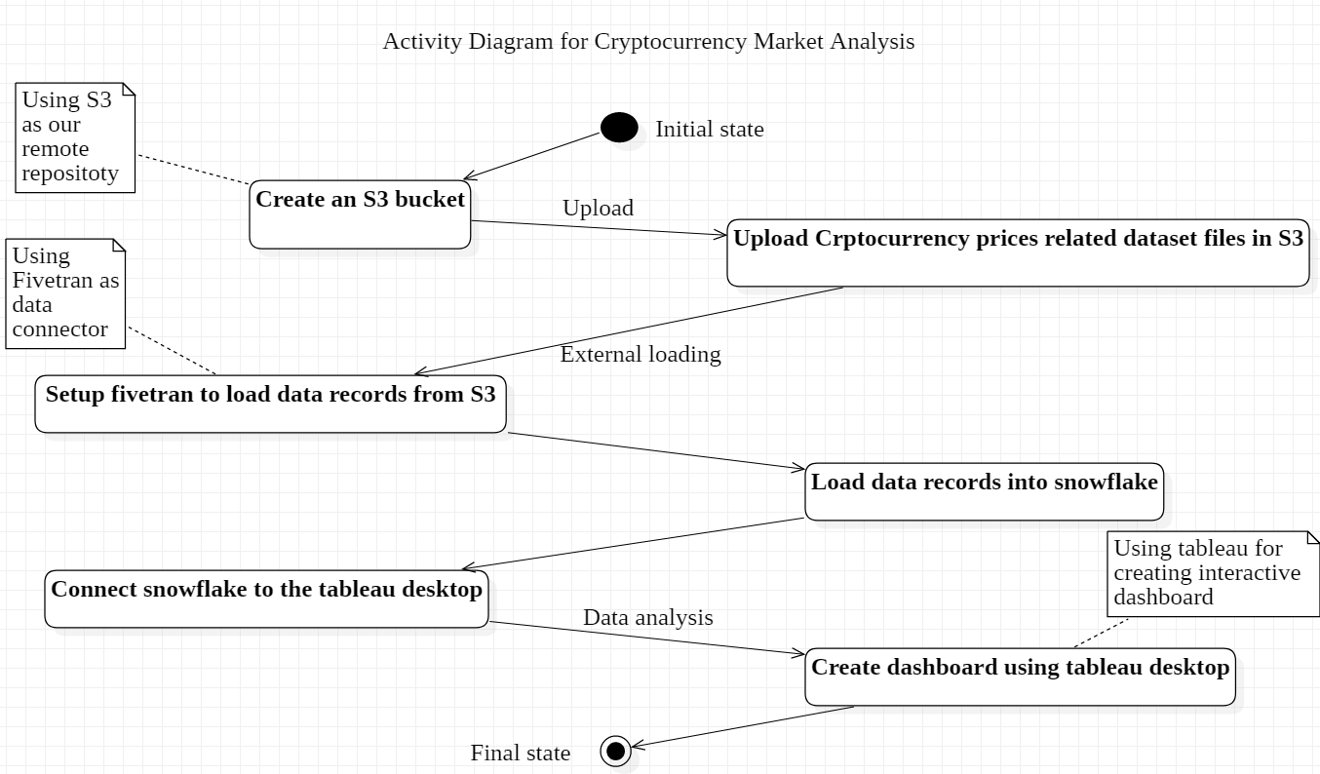
Technical Diagram
Activity Diagram

Slide 15
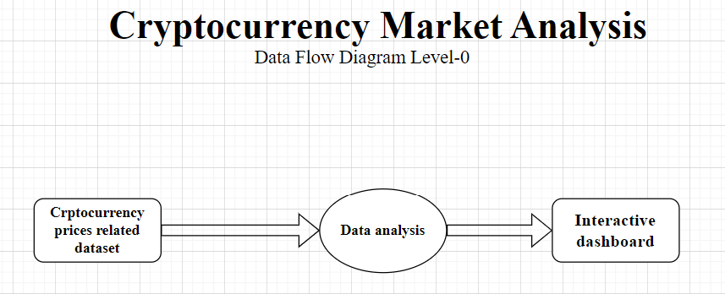
Technical Diagram
DFD Level-0 Diagram

Slide 16
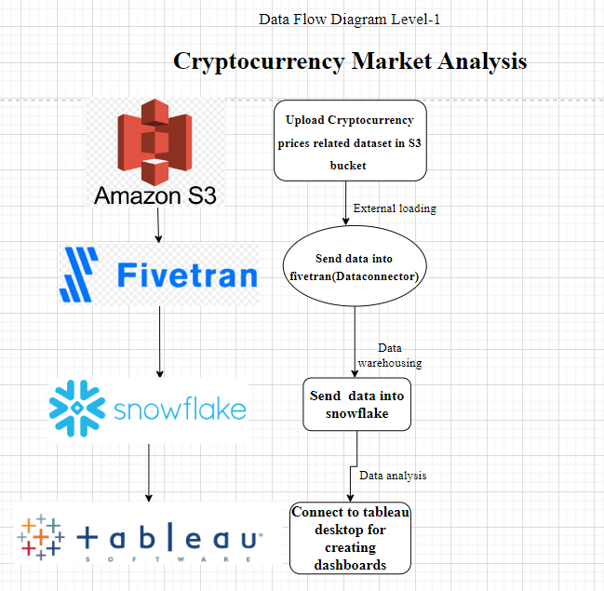
Technical Diagram
DFD Level-1 Diagram

Slide 17
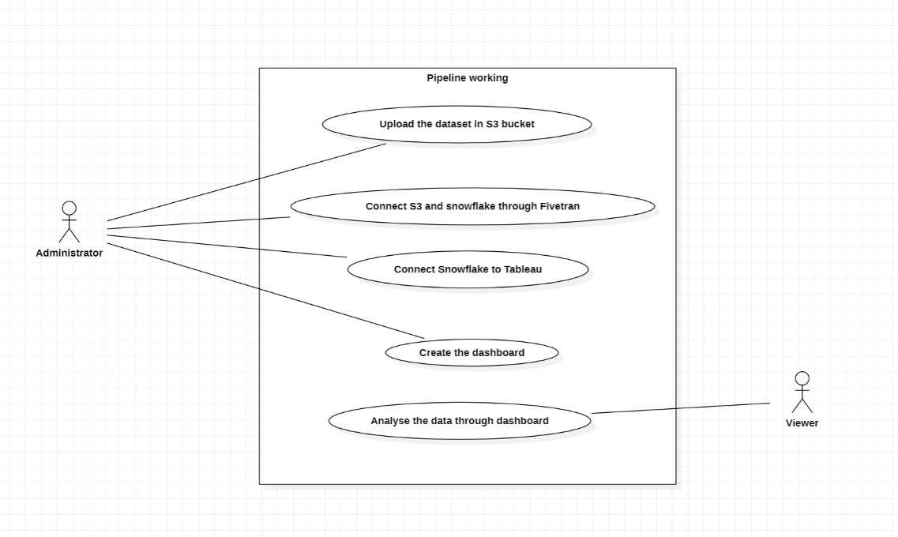
Technical Diagram
Use Case Diagram

Slide 18
Area of Application
The cryptocurrency market analysis can be used in several contexts, including:
Some examples of such scenarios are as follows:
Investment Management: Based on the data presented on the dashboard, investment managers can use the dashboard to track the performance of various cryptocurrencies and make wise investment decisions.
Trading: With the data provided on the dashboard, traders may watch the prices of different cryptocurrencies and make well-informed trading decisions.
Research: Researchers can use the dashboard to examine market trends and patterns for cryptocurrencies, which can help them spot areas that warrant additional investigation.

Slide 19
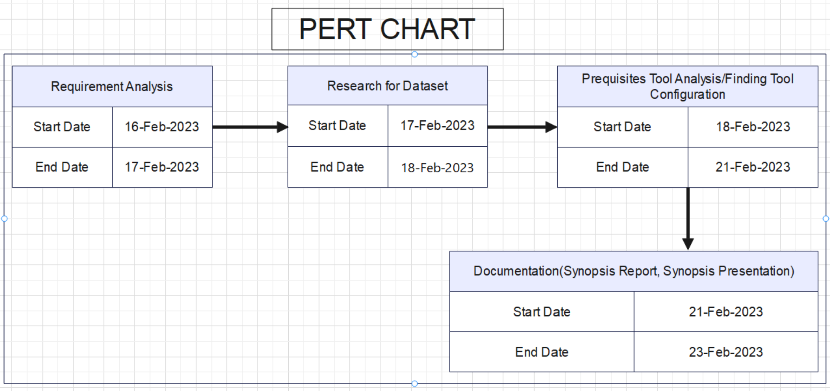
Pert Chart

Slide 20
Reference
[1] Park, Sejung, and Han Woo Park. "Relations between reputation and social media marketing communication in cryptocurrency markets: Visual analytics using Tableau." International Journal of Contents 17.1 (2021): 1-10.
[2] Mikhaylov, Alexey. "Cryptocurrency market analysis from the open innovation perspective." Journal of Open Innovation: Technology, Market, and Complexity 6.4 (2020): 197.
[3] Farell, Ryan. "An analysis of the cryptocurrency industry." (2015).
[4] Mnif, Emna, Anis Jarboui, and Khaireddine Mouakhar. "How has the cryptocurrency market performed during COVID 19? A multifractal analysis." Finance research letters 36 (2020): 101647.

Slide 21
Thank You

